Slide 1
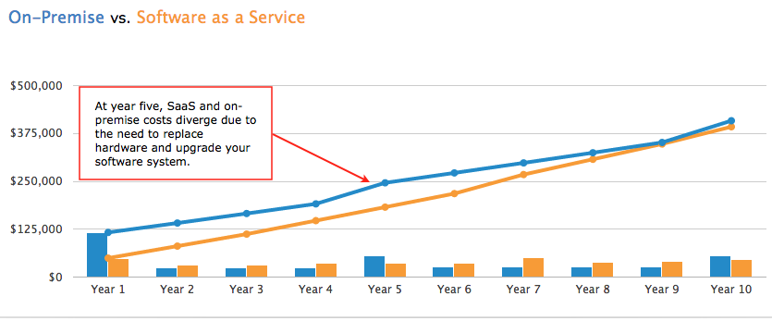
SEIC
http://www.softwareadvice.com/tco/

Slide 2
SEIC
Sources:
http://www.cisco.com/c/en/us/solutions/collateral/service-provider/global-cloud-index-gci/Cloud_Index_White_Paper.pdf
http://www.centaurpartners.com/pdfs/CP_SaaS_Market_Overview.pdf
http://www.softwareadvice.com/tco/

Slide 3
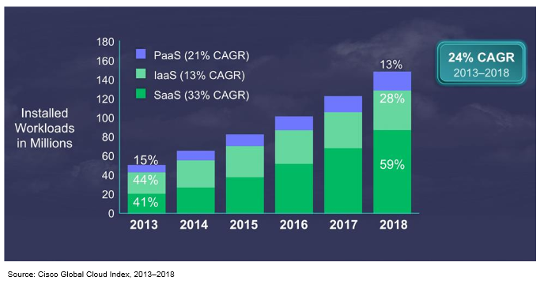

Slide 4
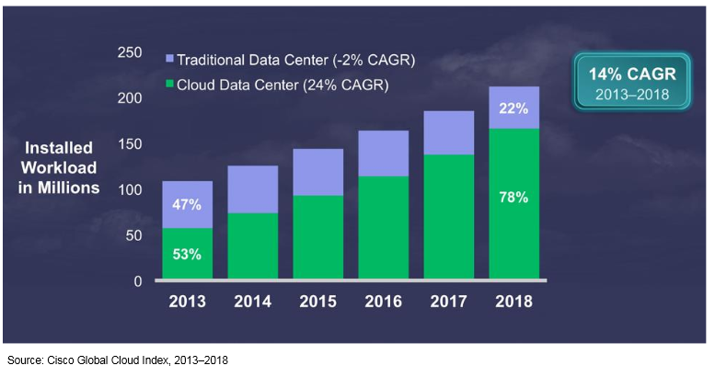

Slide 5
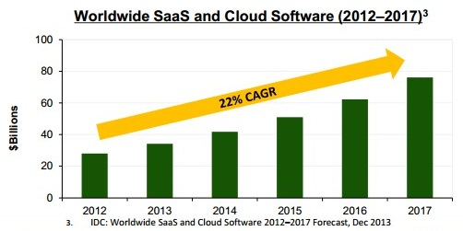

Slide 6
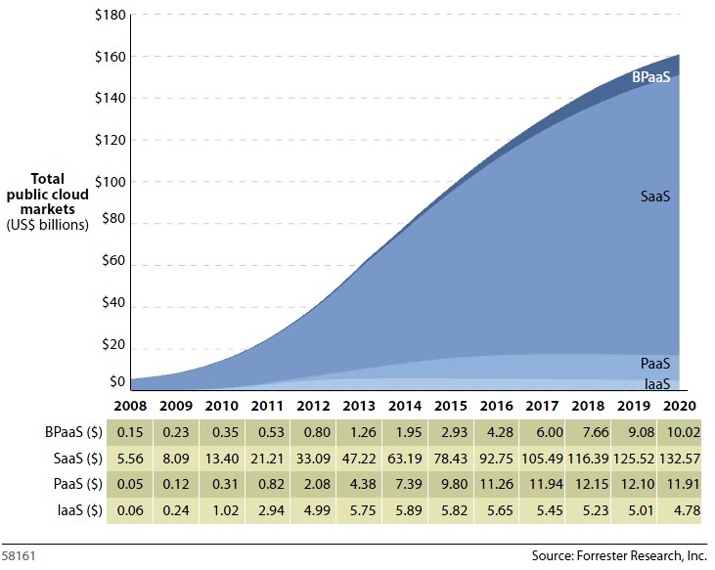

Slide 7
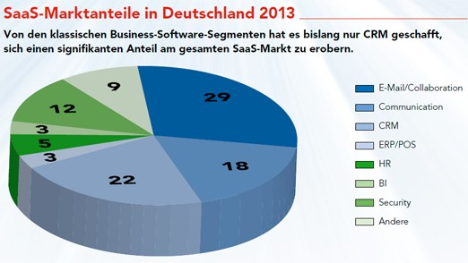

Slide 8
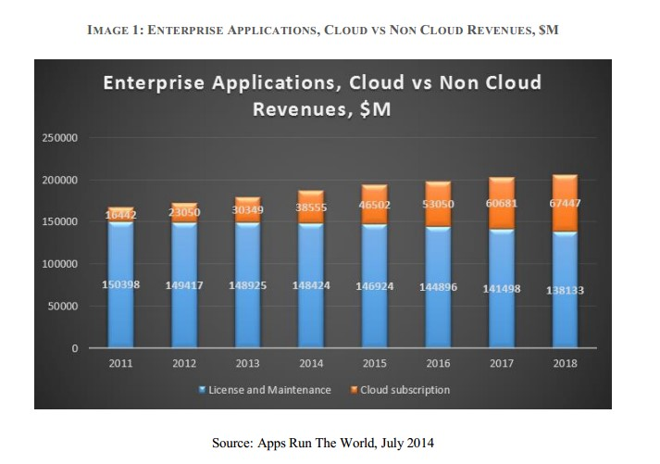

Slide 9
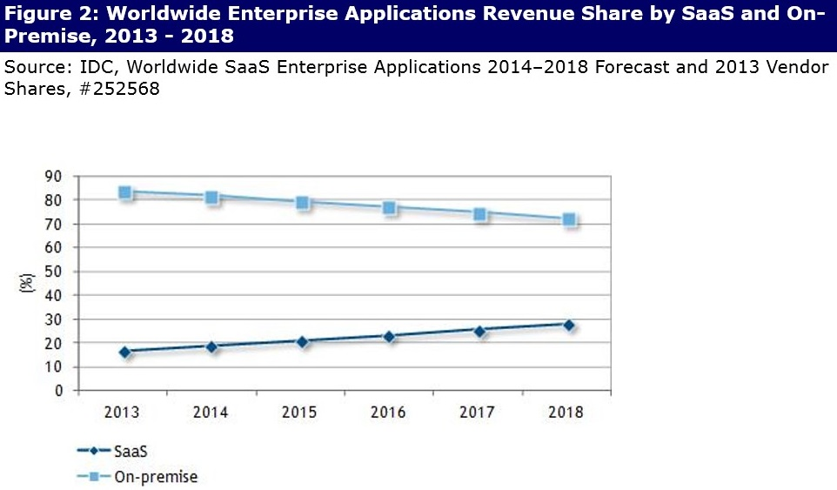

Slide 10
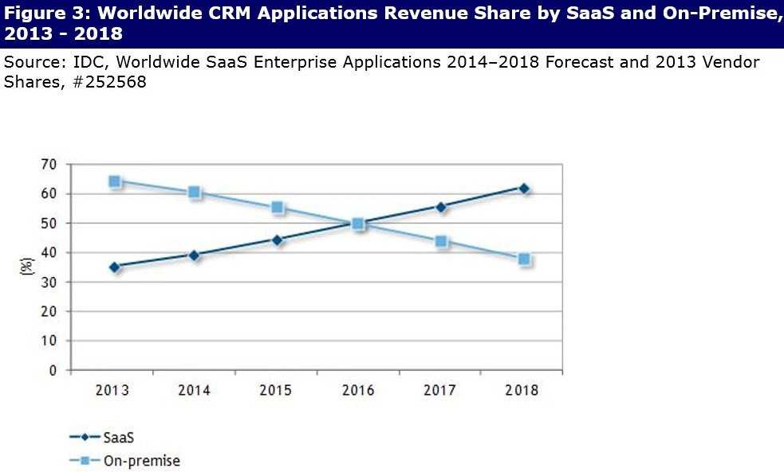

Slide 11
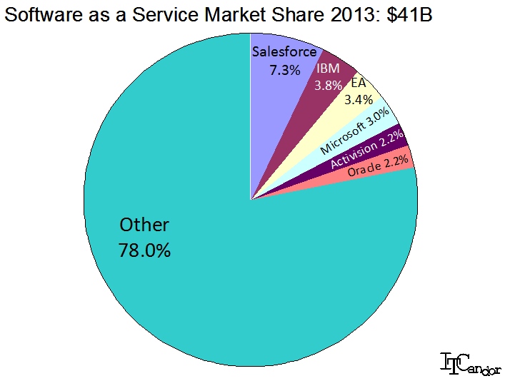

Slide 12
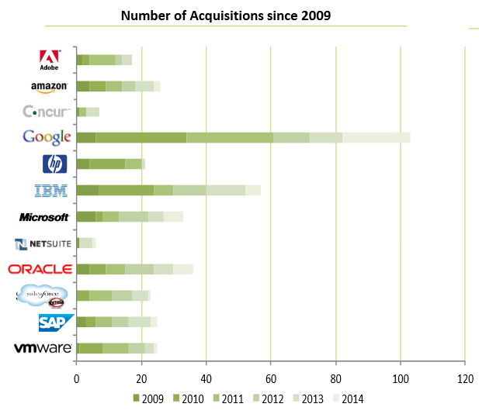
http://www.centaurpartners.com/pdfs/CP_SaaS_Market_Overview.pdf

